Slide 1
“Dirty Work”
Working for the Boy Scouts of America

Slide 2
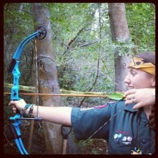
Have you ever seen a girl at a Boy Scout camp?
Working for the Boy Scouts is fulfilling, hard work, and always an adventure.

Slide 3
Working for the Boy Scouts is rewarding

Slide 4
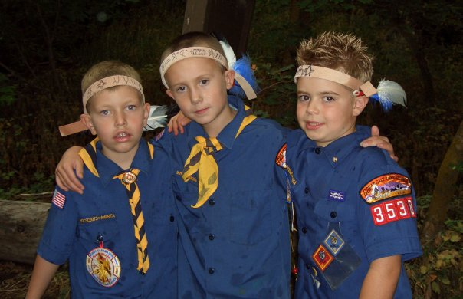
Working with kids brings more energy and light into my life.
“The best way to find yourself is to lose yourself in the service of others.”
- Mahatma Ghandi

Slide 5
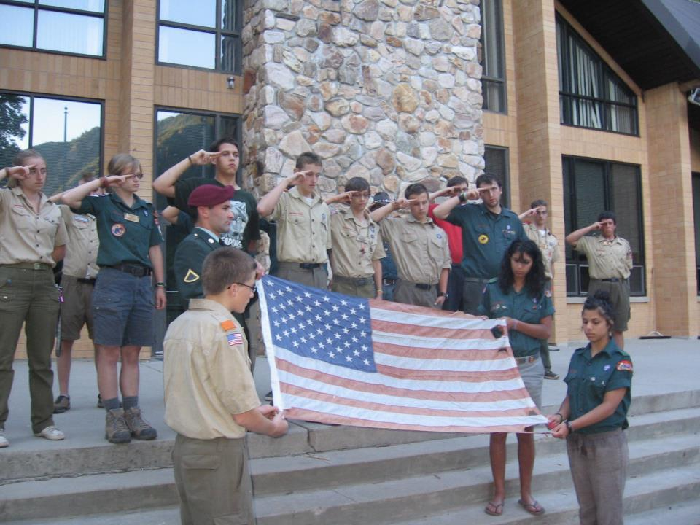
I feel privileged to represent America every time I wear my uniform.

Slide 6
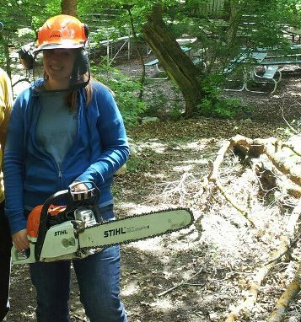
The job requires hard work and dedication

Slide 7
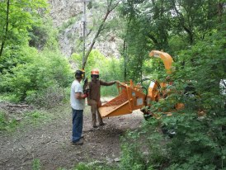
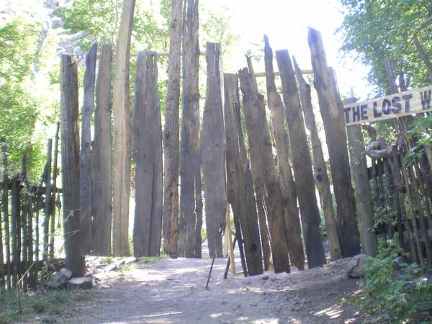
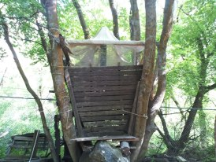
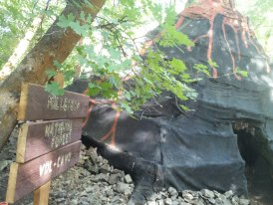

Slide 8
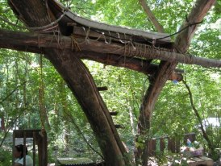
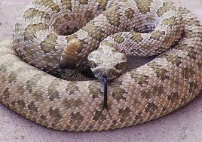
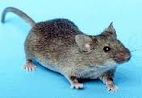
Working for the Boy Scouts is always an adventure.

Slide 9
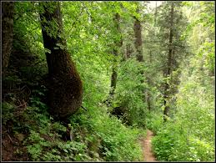
Working for the Boy Scouts is hard, but it is very rewarding.

